Slide 1
Introduction to Machine Learning Welcome
Instructor: Xiaobai Liu

Slide 2
Instructor: Xiaobai LIU
SDSU Computer Vision Lab
1 faculty member
8 master students
3 doctoral students
Many collaborators around the world (MIT, UCLA, Rochester PKU)
Since August 2015
56 peer-reviewed papers published /accepted in top journals or conferences;
Funded by Federal Agencies: DOD DARPA, NSF, ONR.

Slide 3
Campus-wide Events
SDSU AI Club (aiclub.sdsu.edu)
SDSU AI Seminar ( sdsuai.home.blog)

Slide 4
Why need Machine Learning

Slide 5
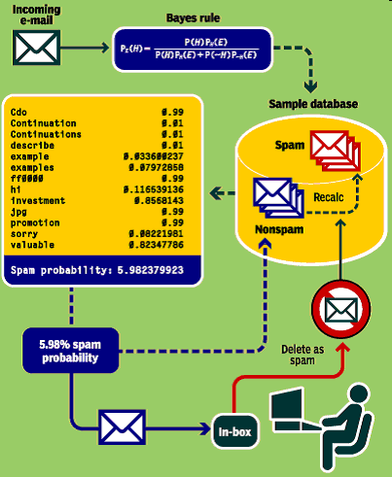
Case: Spam Email Detection
Inputs: emails that were previously marked as spam or ham;
Task: binary classification, is this email ham or spam?
Notes:
Spammers evolve to counter filter innovations

Slide 6
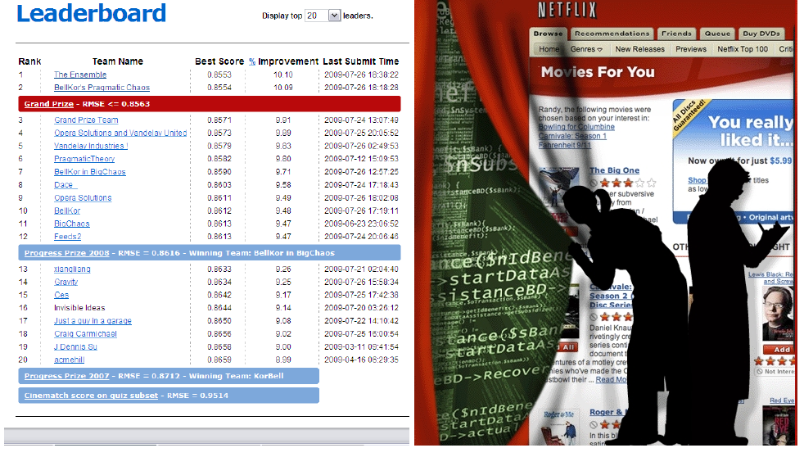
Case: Rating Movie
Notes:
E: available data of ratings
T: completing the missing ratings
P: Accuracy

Slide 7
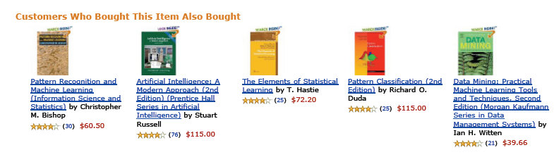
Case: Book Recommendation
how likely a user will purchase a book
Notes:
Books recommended by Amazon.com when viewing Tom Mitchell’s Machine
Learning Book [Mit97]. It is desirable for the vendor to recommend relevant
books which a user might purchase
Experience: history of user behavior
Performance: accuracy

Slide 8
Machine Learning
Machine Learning: Field of study that gives computers the ability to learn without being explicitly programmed.
Arthur Samuel (1959).
Well-posed Learning Problem: A computer program is said to learn from experience E with respect to some task T and some performance measure P, if its performance on T, as measured by P, improves with experience E.
Tom Mitchell (1998)

Slide 9
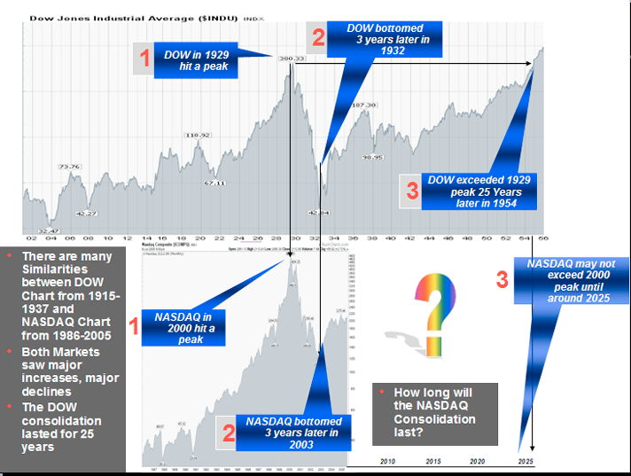
Case: financial forecasting
Predict future market behavior based on data, news reports, expert reviews

Slide 10
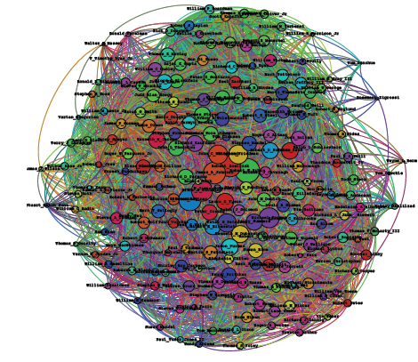
Case: social network &relationships
Inputs: a net work of users and their activities
Outputs: patterns or knowledge that are useful for various purposes
Database of who-knows-who

Slide 11

Case: Face Recognition (Computer Vision)
Input: face images of the same persons
Task: recognize if an unseen face image is the same person

Slide 12
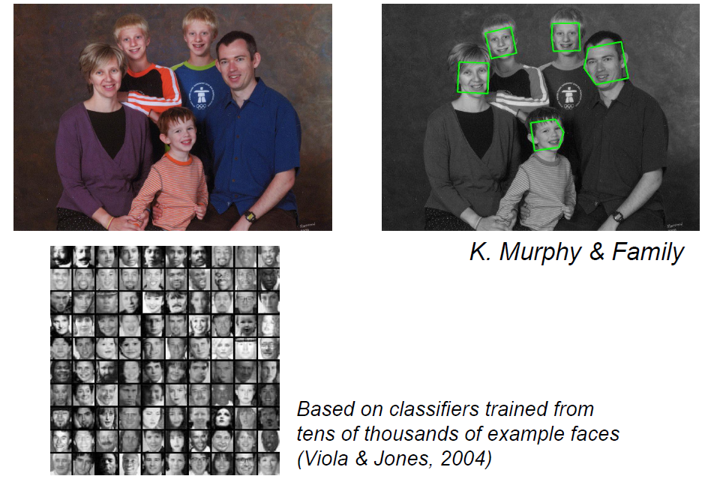
Case: Face Detection (Computer Vision)
Input: images including faces
Task: detecting face boxes

Slide 13
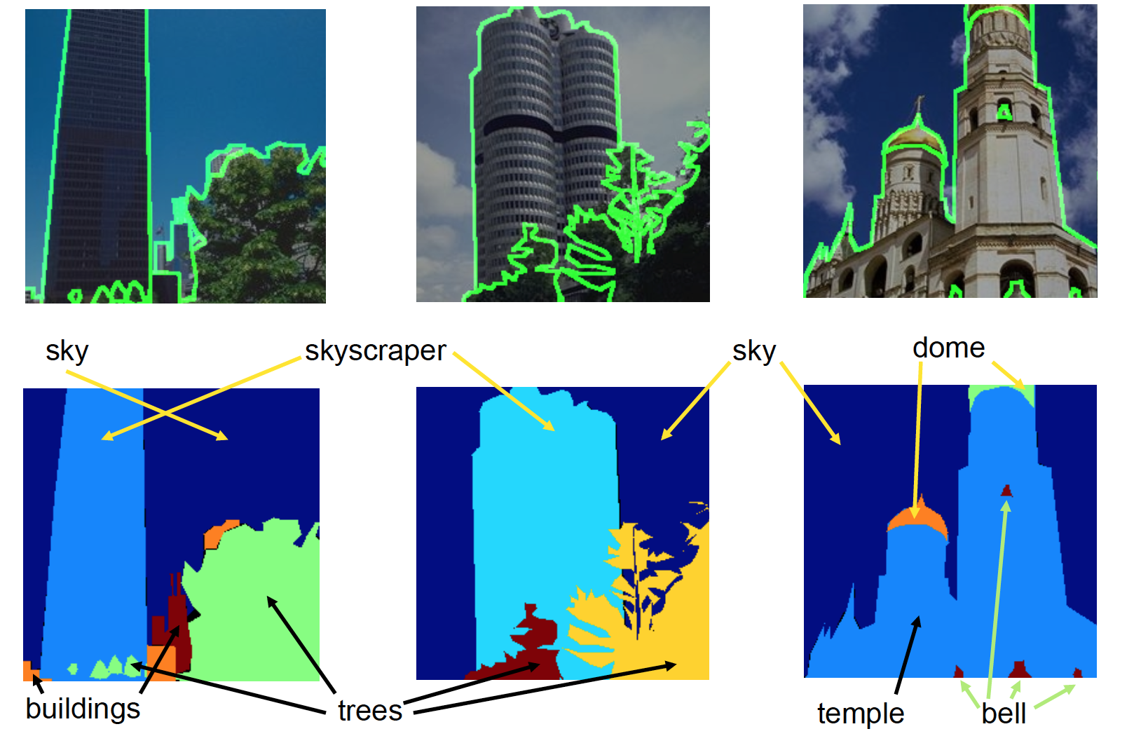
Case: Scene Understanding (Computer Vision)
Input: images of scenes
Task: segments of semantic regions (sky, dome, temple etc.)

Slide 14
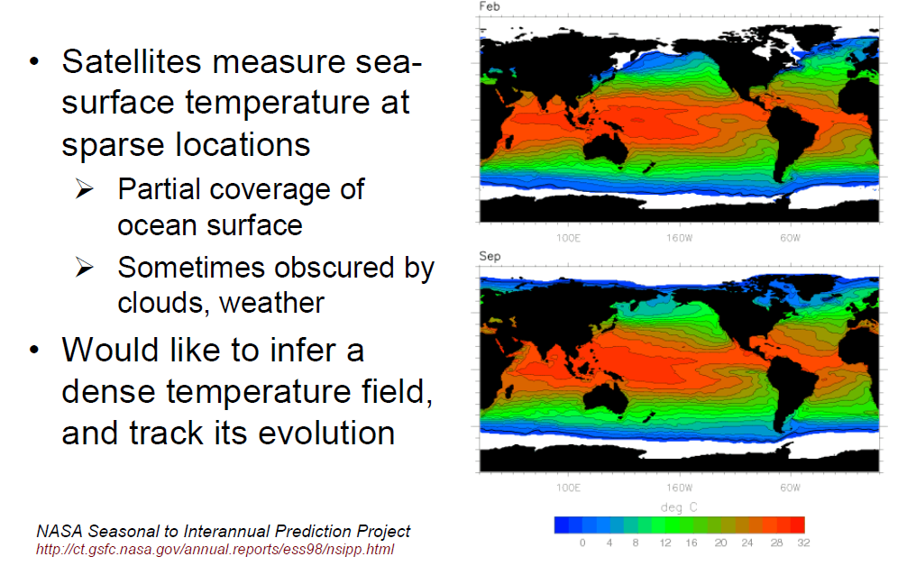
Case: Climate Modeling

Slide 15
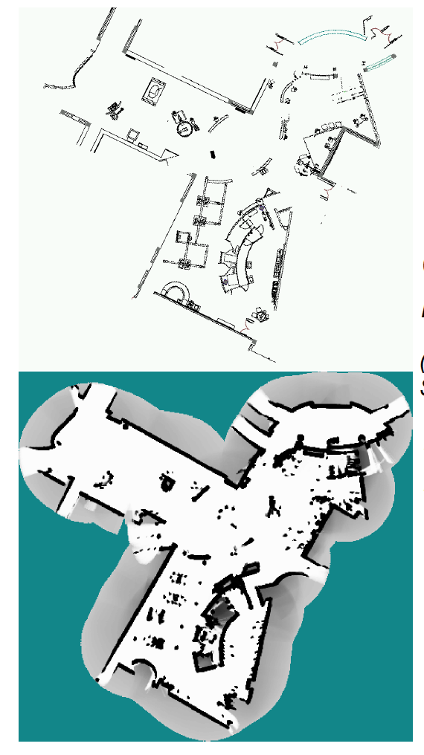
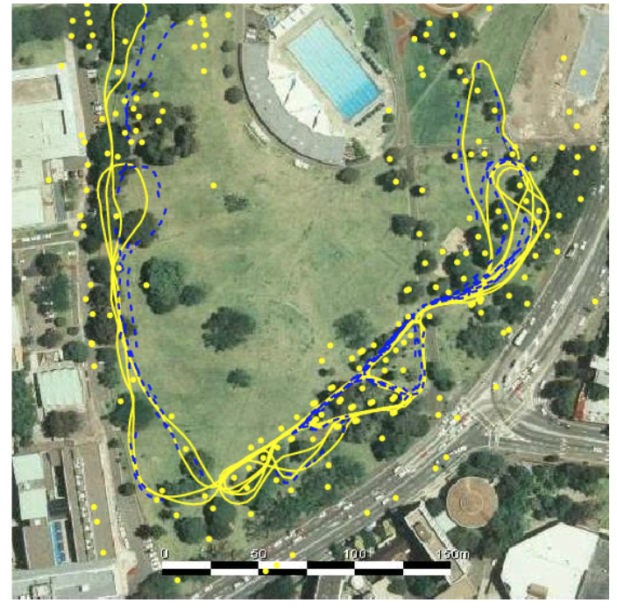
Case: Robot Navigation
Robot system to estimate self-location and geometry

Slide 16
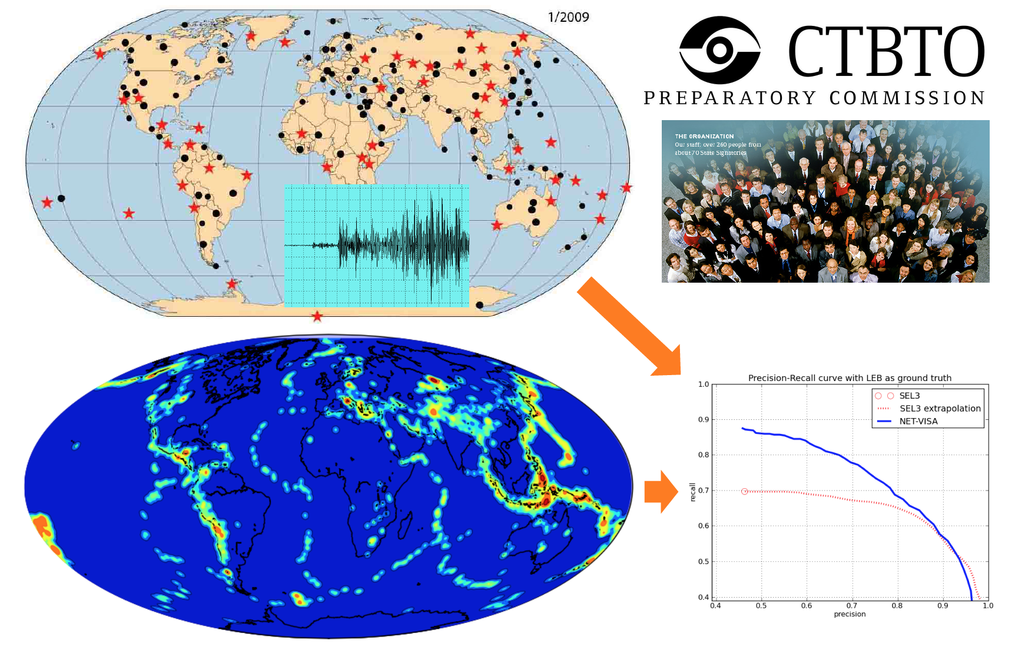
Case: Global Seismic Monitoring

Slide 17
In Summary
Computer Vision | Scene Understanding, Face Recognition, Face Detection, human tracking
Transportation | Self-driving vehicle
Social Network | Spam email detection, Network analysis
Commercial | Movie Rating, book recommendation
Medical | Tumor Diagnose
Financial | Market prediction
Climate | Weather Prediction
Robot | Mapping, localization
Geology | Seismic Analysis
….

Slide 18
Recap: Machine Learning
Predicting the future from the past
Past: training data, collection of examples
Future: knowledge/information about novel examples
Examples
Binary classification: is it spam or not?
Clustering: how many communities in FACEBOOK network?
Recognition: what sentence was spoken?
Detection: when and where have seismic events(earthquakes) occurred?

Slide 19
Course Topics
Linear Regression
Logistic Regression
Machine Learning Theories
Neural Network
Support Vector Machine
Unsupervised learning
Ensemble methods: bagging and boosting
Dimensionality Reduction
Subspace Learning

Slide 20
Course Organization
In-class meeting
Interactions
Discussions
After-class coding
6 homework
Programming Languages
Python

Slide 21
What you can learn
Given two candidate machine learning models, which is better?
Accuracy
Complexity
Are all mistakes are equally bad?
Given a family of classifiers with free parameters,
General design principles?
What happen if more data?
Can I test all possible classifiers?
Too many parameters?
Notes:
How to extract/learn informative features?
Which models is the best?
Complexity of classification?
Are all mistakes equally bad?
Are there general design principles?
How to deal with more data?
How to test classifiers?
How to tune parameters?

Slide 22
Evaluation
Homework Assignment (HA, usually due in 1-2 weeks, 50%)
10% HA1: Programming Environment
10% HA2
10% HA3
10% HA4
10% HA5
Final Exam (25%)
Final Project (25%)
Extra Credits (5%)
Extra-efforts for assignments
In-class interactions
Class Attendance

Slide 23
Resources
Gradebook (updates weekly)
Slides (updated after class meetings)
Sample codes
Homework assignments
Textbooks
Optional Reading: Textbook I : An Introduction to Machine Learning with Python, by Andreas C. Muller and Sarah Guido (O’Reilly). Copyright 2017 Sarah Guido and Andreas Muller, 978-1-449-36941-5. Online available
Optional Reading: Machine Learning: a Probabilistic Perspective by Kevin Patrick Murphy Online available, http://www.cs.ubc.ca/~murphyk/MLbook/
Optional Reading: Pattern Recognition and Machine Learning, Christopher M. Bishop, Springer-Verlag New York, Inc. Secaucus, NJ, USA ©2006 ISBN:0387310738

Slide 24
Office hours
Instructor: Dr. Xiao-bai Liu
Office hours: 11:00-11:50am, Tuesday/Thursday
Appointment by emails: Xiaobai.liu@sdsu.edu
Notes:
GUPTA, NISHANT1A:

Slide 25
Take-home Materials
iPython Tutorial (or jupyter notebook) , 4 pages
Python Numpy Tutorial,27 pages
Python Basics 20 pages
lecture00. Python.pptx, 30 slides

